Slide 1
Stroke Prediction A Machine Learning approach
Monirul Islam Mahmud – 2011839042
Md Shihab Reza - 1931229042
Team - Neural Ninjas

Slide 2
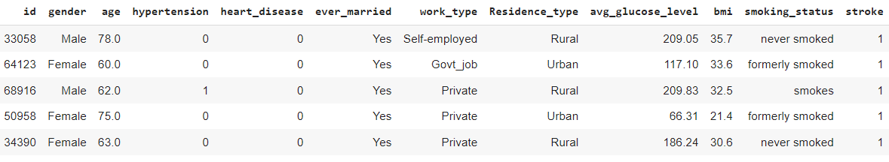
Dataset Info
(Public Dataset)
5780 unique data.
Combination of Kaggle & UCI
(Private Dataset)
114 unique data.
Collected from Hospital.
100 more yet to receive.

Slide 3
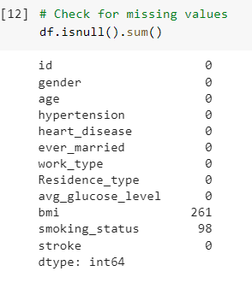
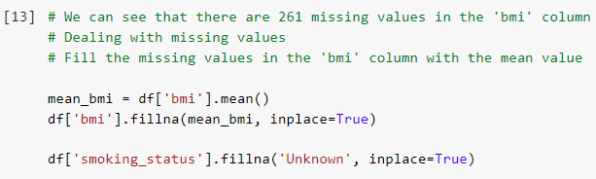
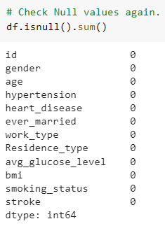

Missing Data Handle
We have filled the missing value with Mean Bmi value because as bmi increases it has a higher chance that it will be stroke patient. Then we also fill with ‘Unknown’ in smoking status null values.
We can see 261 & 98 Null Values in BMI and Smoking status.
There is no Null values after handling missing value.

Slide 4
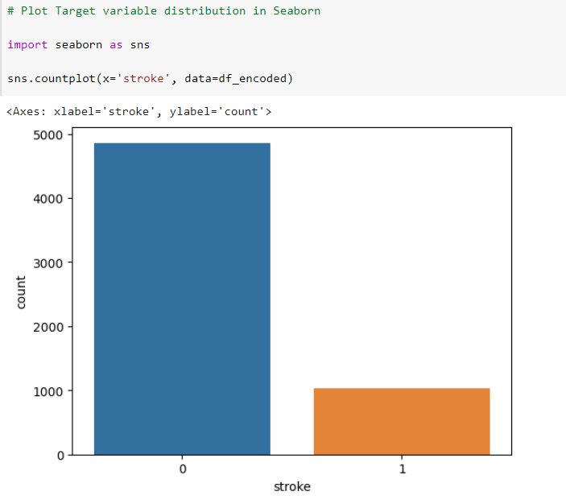
Target Variable distribution
Let's first take a look at the distribution of the target variable 'stroke’. We can see that the dataset is ‘highly imbalanced’ with only a small fraction of the samples having a stroke.

Slide 5
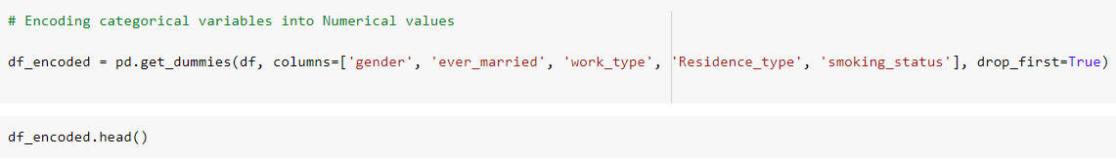
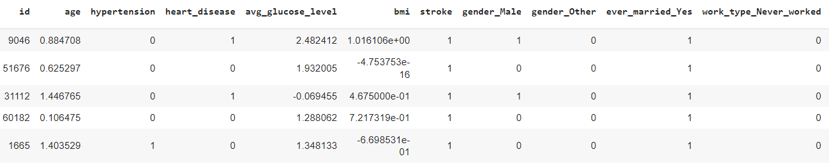
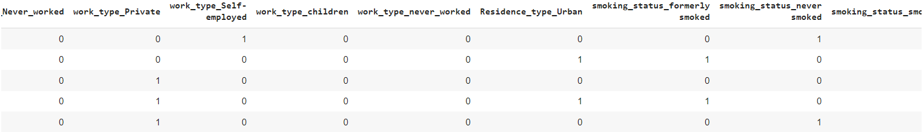
One Hot Encoding
We can use the pandas function get_dummies() to one-hot encode these categorical variables. We have used drop_first = True to avoid multicollinearity.

Slide 6
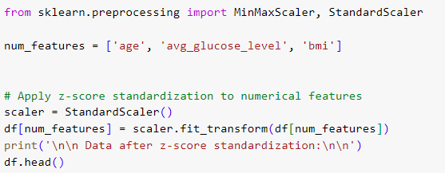
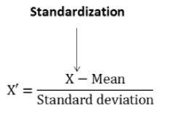
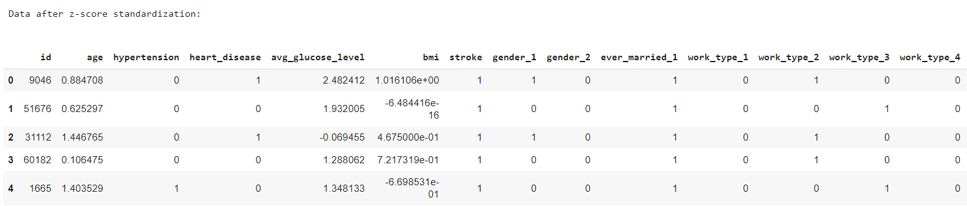
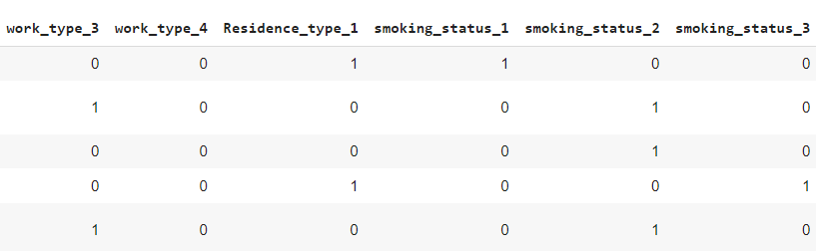
Standard Scaler
We need to scale the numerical variables 'age', 'avg_glucose_level', and 'bmi' so that they have similar scales. We can use the Standard Scaler function from the scikit-learn library to do this.

Slide 7
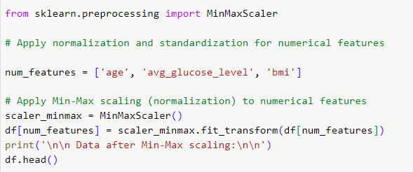
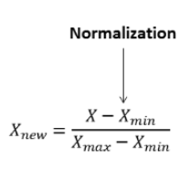
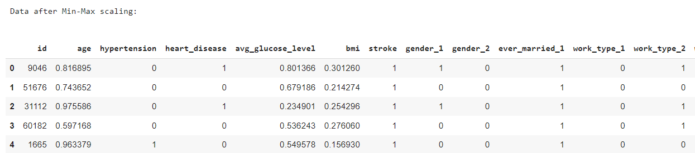
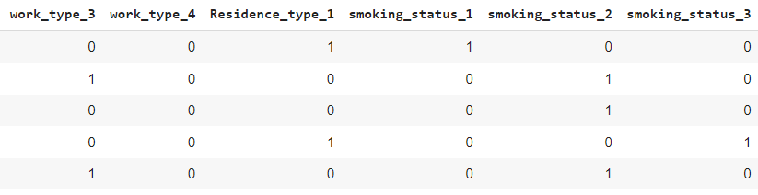
Normalization
We have also used Min Max Scaler from Scikit learn library to scale all the numerical features.

Slide 8
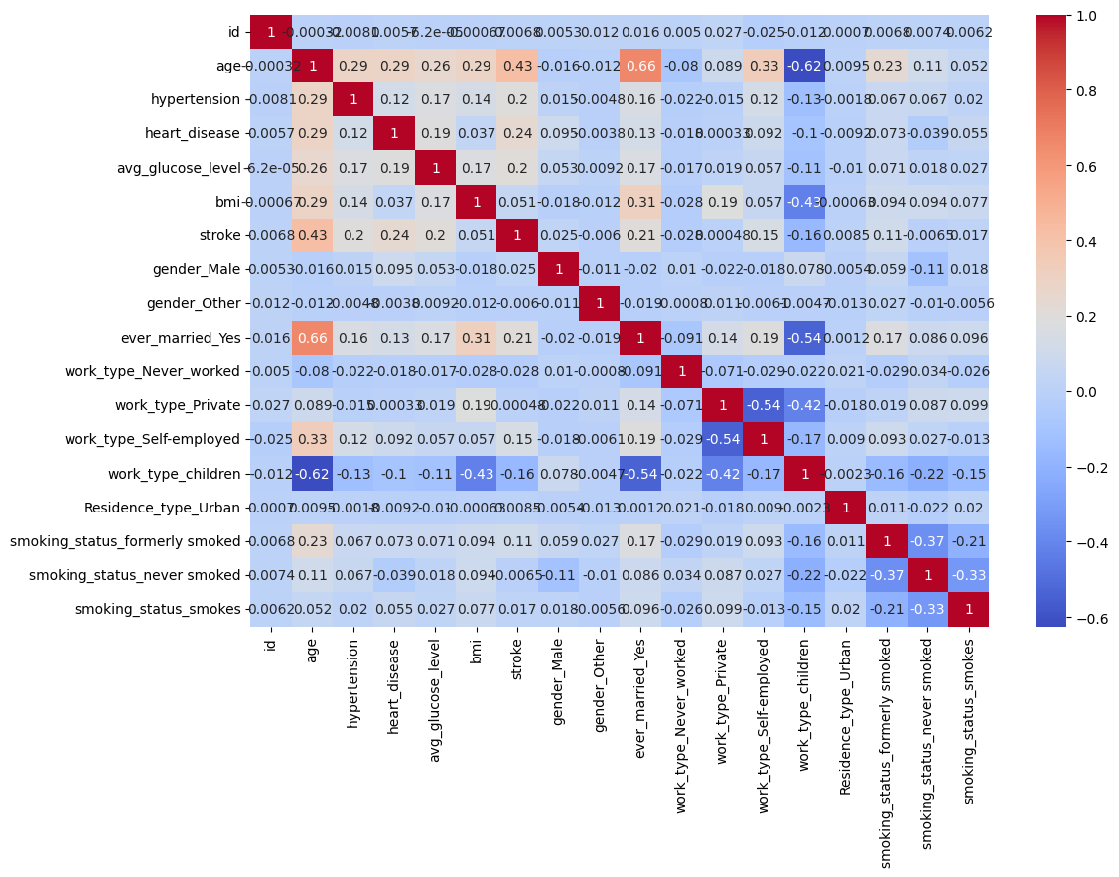
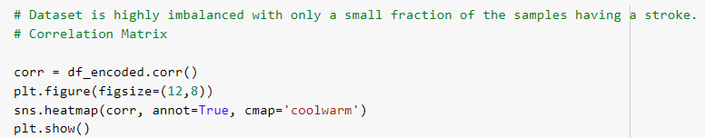
Correlation Matrix
Strong Positive Correlations: 'ever_married_Yes' and 'age’, age and stroke, age and smoking_status_formerly_smoked etc.
Strong Negative Correlations: age and work_type_children, bmi and work_type_children, gender_male and smoking_status_never_smoked etc.

Slide 9
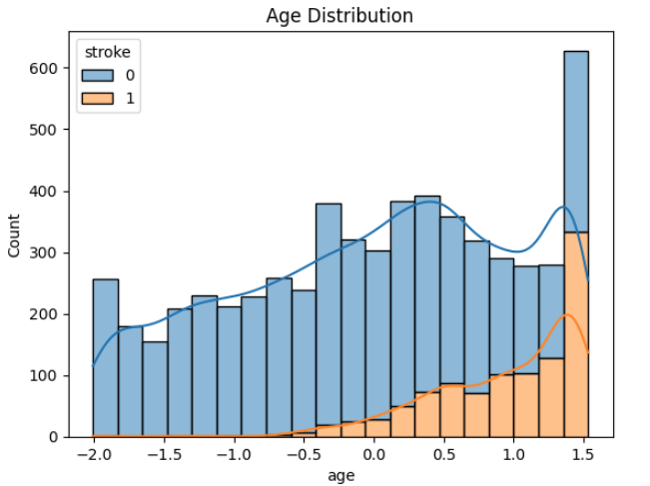
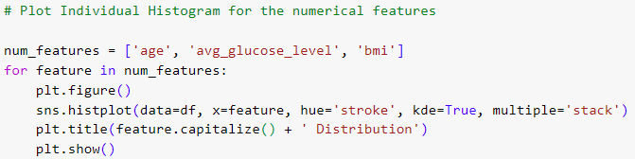
Histogram for the Numerical Features
We can see that the distribution of age is right-skewed and the number of strokes increases with age.
Observation

Slide 10
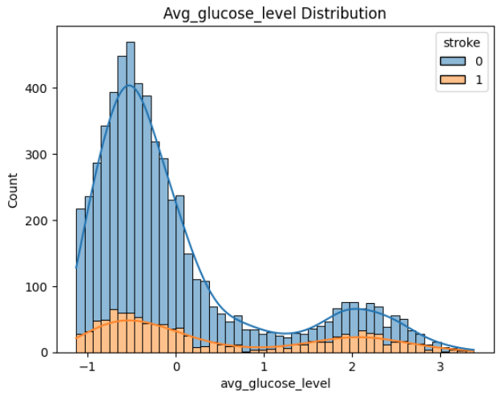
We can see that the distribution of glucose level is also right-skewed and there is a higher probability of stroke for people with higher glucose levels.
Observation

Slide 11
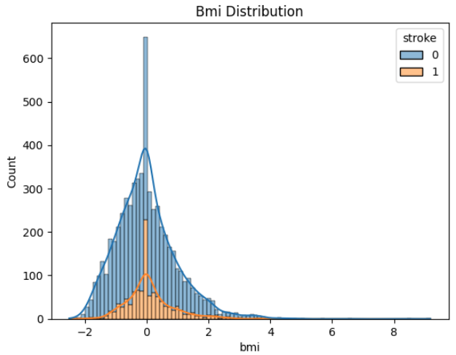
We can see that the distribution of BMI is almost normal and there is a higher probability of stroke for people with higher BMI.
Observation

Slide 12
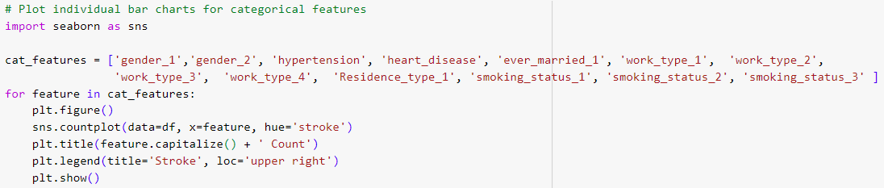
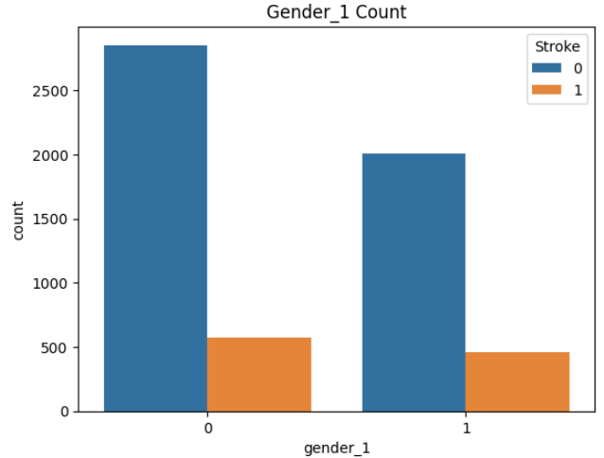
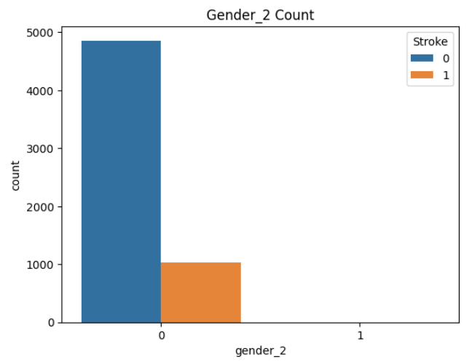
Bar Chart for Categorical Features
We can see, Male has higher chance of Stroke than Female gender.
Observation

Slide 13
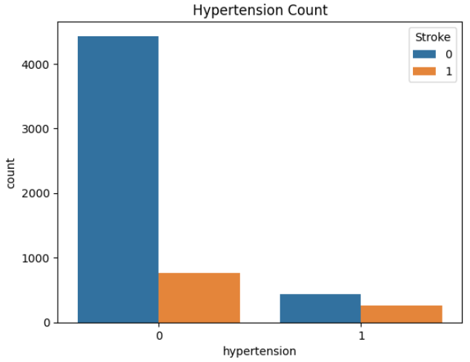
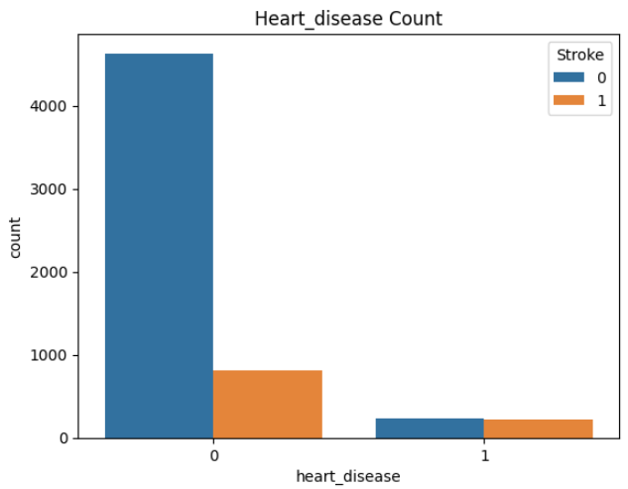
We can see, Hypertense person and person with Heart Disease has higher chances of Stroke.
Observation

Slide 14
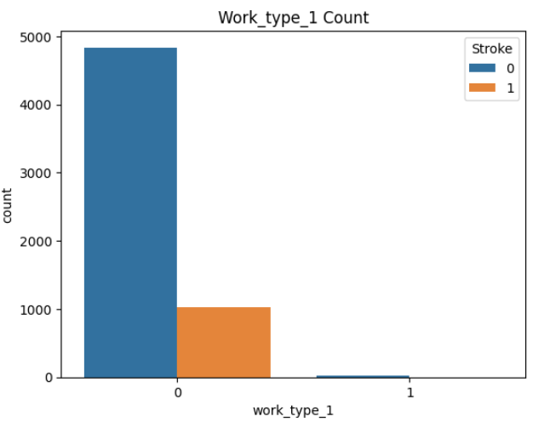
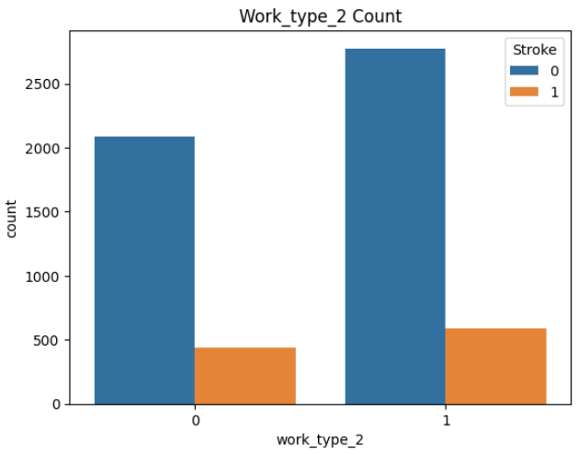
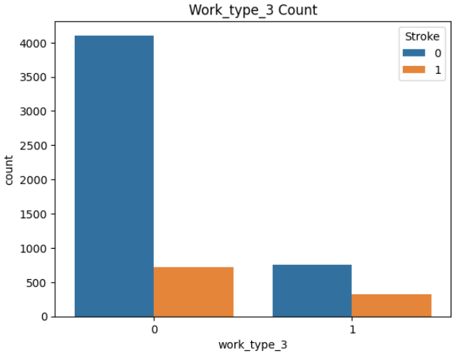
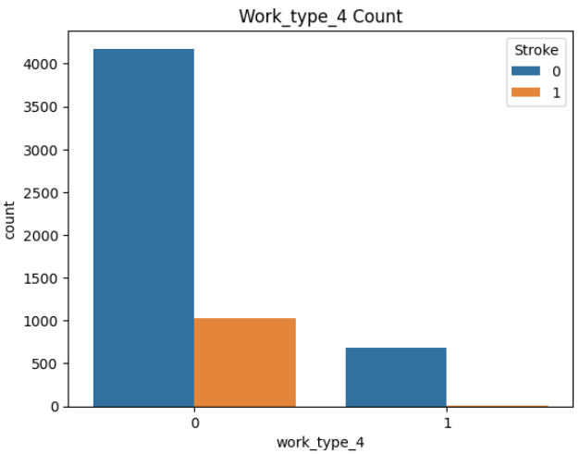
We can see, Work Type 2 (Private) and Work type 3 (Self Employed) have higher chances of having Stroke.
Observation

Slide 15
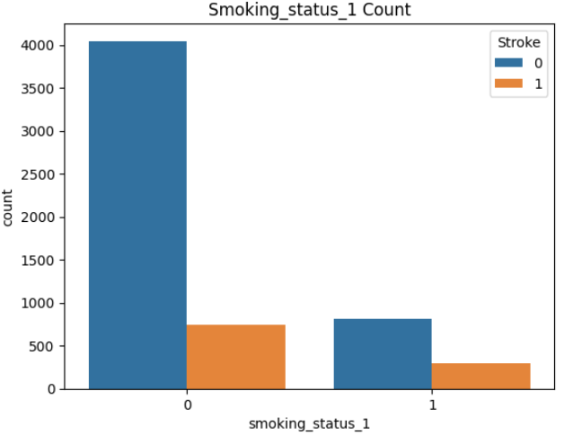
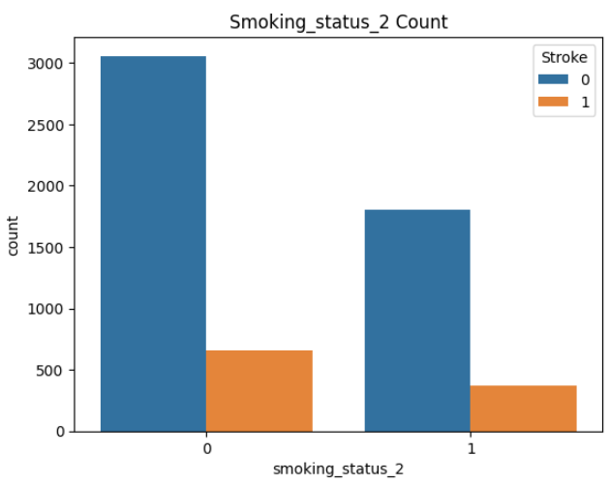
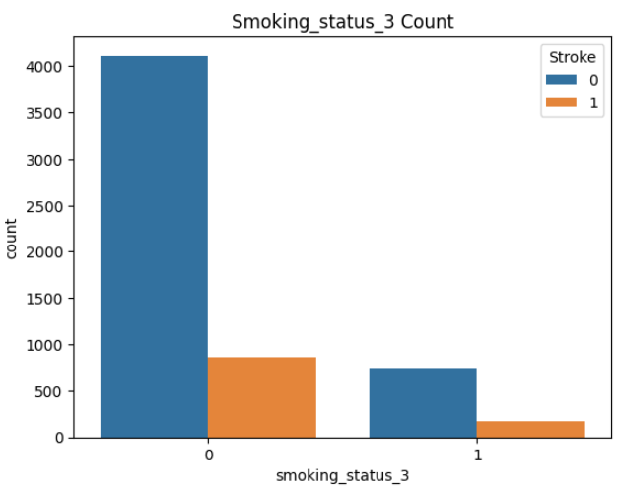
We can see, people with Smoking Status 1 (Formerly Smokes) and Smoking Status 3 (Smokes) have higher chances of stroke.
Observation

Slide 16
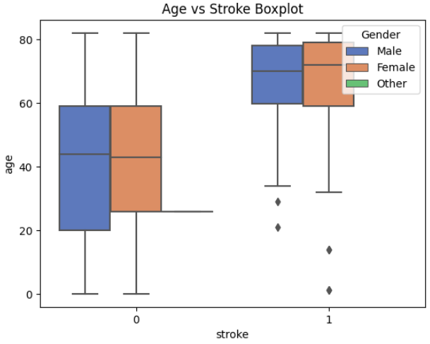
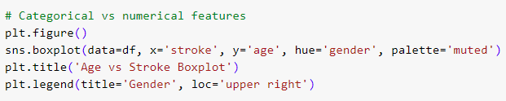
Box Plot for Categorical vs Numerical Features
This graph presents boxplots of age for each stroke category (having a stroke or not). The boxes represent the interquartile range (IQR) of age values, and the whiskers extend to the minimum and maximum values. The boxplots are further divided by gender using different colors.
Observation

Slide 17
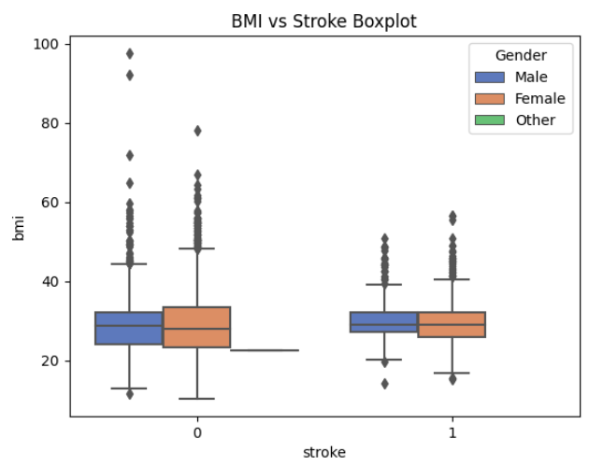

This graph displays boxplots of BMI (Body Mass Index) for each stroke category. Similar to the previous graph, the boxplots are divided by gender.
Observation

Slide 18
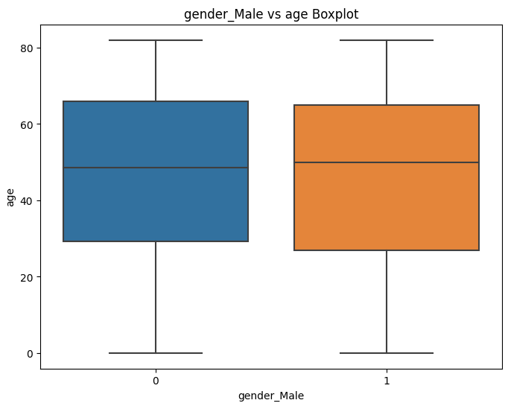
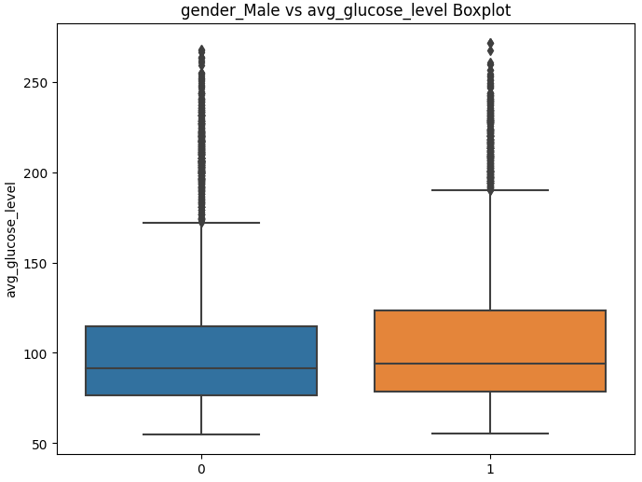
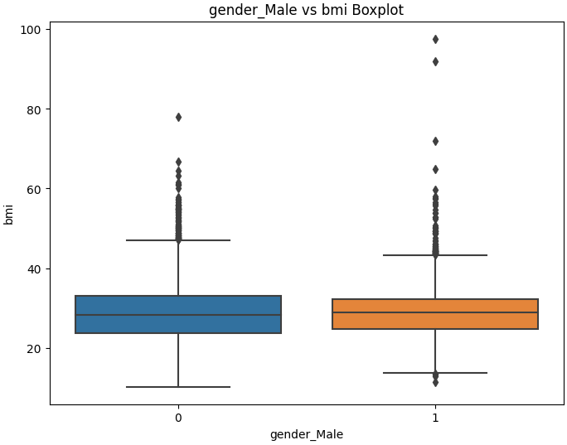
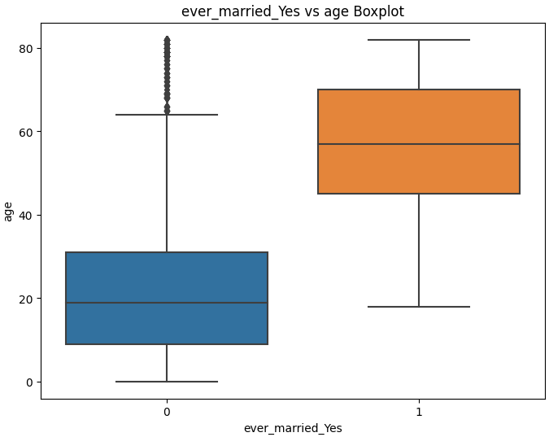
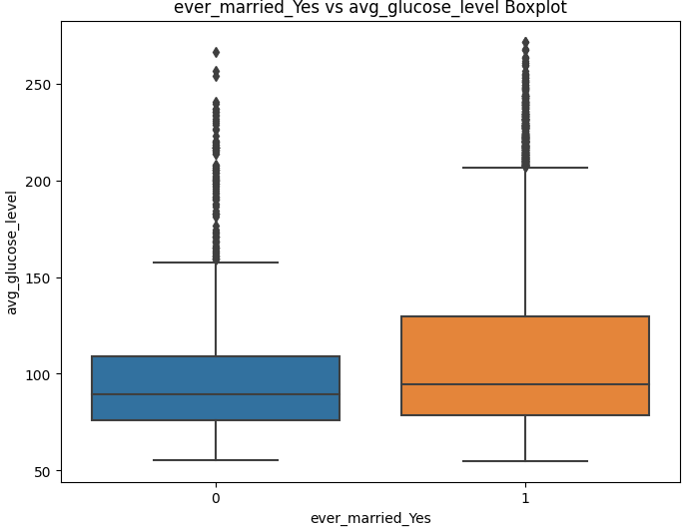
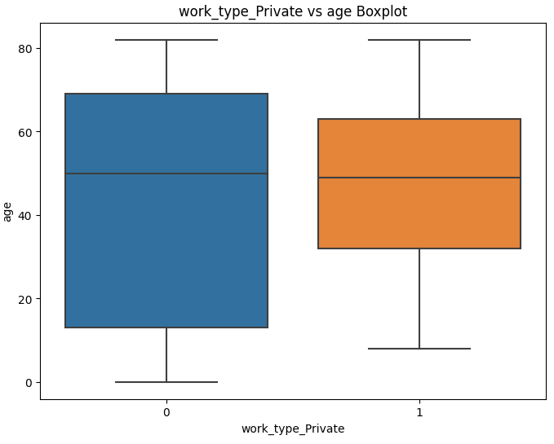

Slide 19
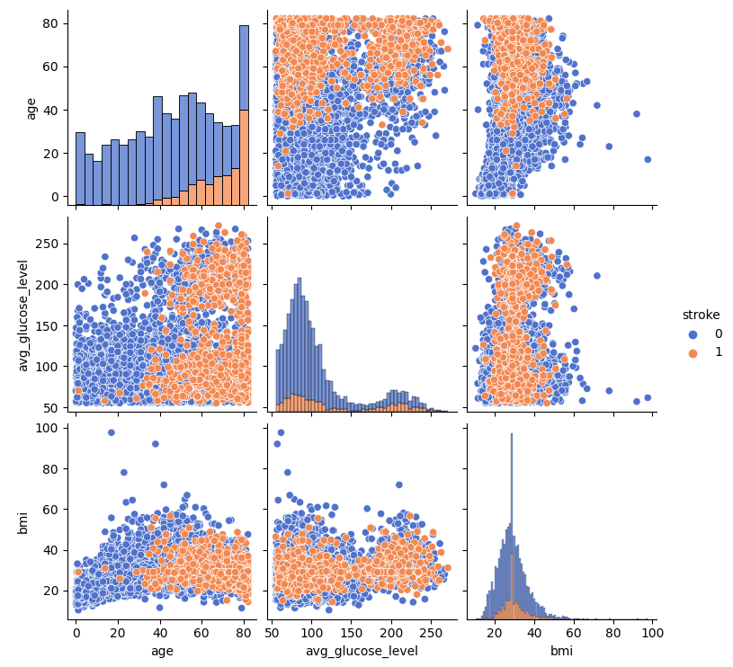
Pair Plot for Numerical vs Numerical Features
This graph is a pair plot that shows the relationships between numerical features: age, average glucose level, and BMI. Each scatter plot represents the relationship between two features, with the points colored by stroke category. The diagonal axes show histograms for each feature, stacked according to the stroke category.
Observation

Slide 20
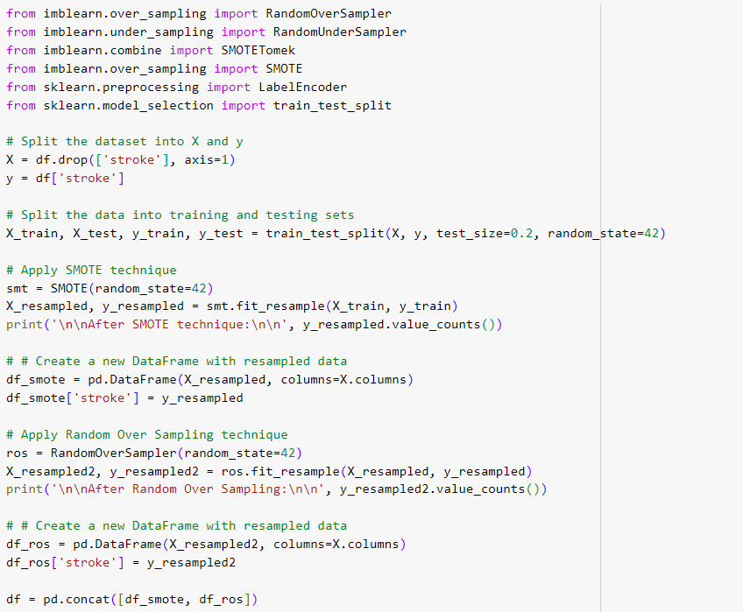
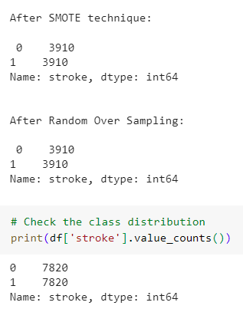

Balancing technique (SMOTE & Oversampling)

Slide 21
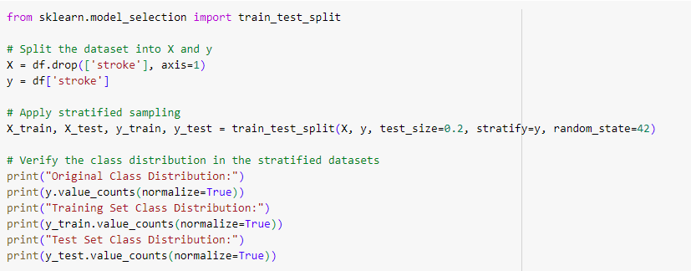
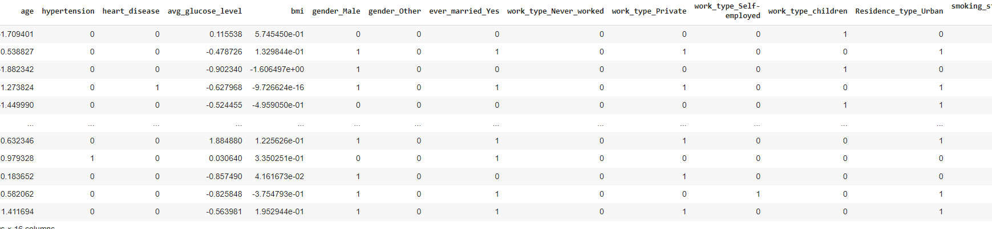
Stratified Sampling
“stratify=y” parameter ensures that the splitting process maintains the same class distribution in the training and testing sets as in the original dataset.

Slide 22
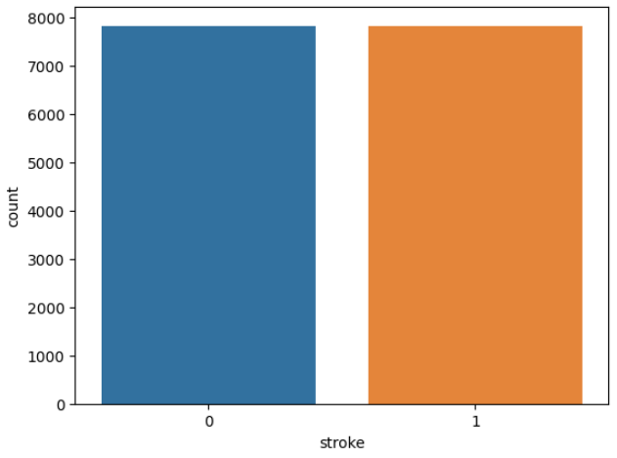
Count plot Before & After Balancing
Before Applying Balancing Technique
After Applying Balancing Technique

Slide 23
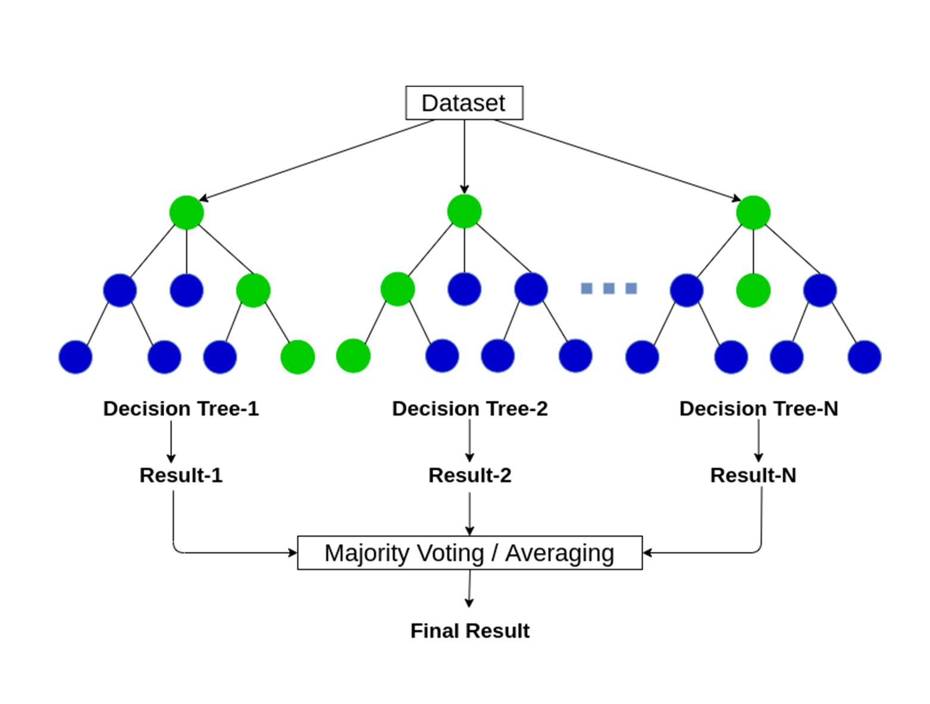
Model Training
Random Forest
Random Forest is a popular machine learning algorithm that belongs to the supervised learning technique. It can be used for both Classification and Regression problems in ML.
Random Forest is a classifier that contains a number of decision trees on various subsets of the given dataset and takes the average to improve the predictive accuracy of that dataset.

Slide 24

Model Training
Decision Tree
Decision Tree is a Supervised learning technique that can be used for both classification and Regression problems, but mostly it is preferred for solving Classification problems.
It is a tree-structured classifier, where internal nodes represent the features of a dataset, branches represent the decision rules and each leaf node represents the outcome.
It is a graphical representation for getting all the possible solutions to a problem/decision based on given conditions.

Slide 25

Model Training
K-Nearest Neighbors (KNN)
K-NN algorithm can be used for Regression as well as for Classification but mostly it is used for the Classification problems.
K-NN algorithm stores all the available data and classifies a new data point based on the similarity. This means when new data appears then it can be easily classified into a well suite category by using K- NN algorithm.
K-NN algorithm assumes the similarity between the new case/data and available cases and put the new case into the category that is most similar to the available categories.

Slide 26

Model Training
Naive Bayes
Naïve Bayes algorithm is a supervised learning algorithm, which is based on Bayes theorem and used for solving classification problems.
It is a probabilistic classifier, which means it predicts on the basis of the probability of an object.
ayes' theorem is also known as Bayes' Rule or Bayes' law, which is used to determine the probability of a hypothesis with prior knowledge.

Slide 27

Model Training
Support Vector Machine
Support Vector Machine or SVM is one of the most popular Supervised Learning algorithms, which is used for Classification as well as Regression problems. However, primarily, it is used for Classification problems in Machine Learning.
SVM chooses the extreme points/vectors that help in creating the hyperplane. These extreme cases are called as support vectors, and hence algorithm is termed as Support Vector Machine.

Slide 28

Model Training
Gradient Boosting
Gradient Boosting is a popular boosting algorithm in machine learning used for classification and regression tasks.
Gradient Boosting can use a wide range of base learners, such as decision trees, and linear models.
Gradient Boosting is generally more robust, as it updates the weights based on the gradients, which are less sensitive to outliers.

Slide 29

Model Training
Logistic Regression
Logistic regression predicts the output of a categorical dependent variable. Therefore the outcome must be a categorical or discrete value.
It gives the probabilistic values which lie between 0 and 1. Logistic regression is used for solving the classification problems.
Logistic Regression can be used to classify the observations using different types of data and can easily determine the most effective variables used for the classification.

Slide 30


Model Train
7 ML Model Train Test
Evaluate Model Performance

Slide 31

Compare Result of Balancing Technique

Slide 32


Model Evaluation
Accuracy: The percentage of correct predictions out of the total predictions.
Precision: The proportion of true positive predictions out of the total positive predictions.
Recall: The proportion of true positive predictions out of the total actual positives.
F1 Score: A measure that combines precision and recall into a single metric, providing a balanced evaluation.

Slide 33




Model Evaluation Diagram
Random forest Decision Tree are higher in accuracy, precision and f1 score.
But Recall is higher in Naive Bayes Algorithm.

Slide 34


ROC Curve
The ROC curve function calculates the false positive rate (fpr) and true positive rate (tpr) at various thresholds. The area under the curve (AUC) is calculated using the auc function.

Slide 35


Cost Function
Decision Tree and Random forest gives the lowest RMSE, MSE, MAE value which means predicted values are closer to the actual values and the model makes fewer errors in its predictions.

Slide 36




Confusion Matrix
KNN gives good performance as it gives higher amount of TP & TN values.
Naive Bayes gives worst performance as it gives higher range of FP value.

Slide 37



Confusion Matrix
Random forest Decision Tree give best performance as it gives higher amount of TP & TN values with 0 FP & FN value.
Logistic Regression gives worst performance as it gives higher range of FP & FN value.

Slide 38


Pandas Profiling

Slide 39

Pandas Report

Slide 40

Pandas Report

Slide 41

Work Distribution
Monirul Islam Mahmud
Hafeza Akter
ML Model Selection
Feature Extraction
Model Training
SMOTE & Oversampling
Backend API Develop
Writing Paper
Collecting Dataset
Data Preprocessing
Cost Function
Model Evaluation
Website Ui develop
Writing Paper

Slide 42

Summary
In this EDA and data preprocessing, we have performed encoding and scaling of the features, and performed exploratory data analysis to understand the distribution of the features and the target variable.
We have used Standardization, Resampling Techniques (Oversampling & SMOTE) in this EDA for balancing Data. We will also add more Stroke Patient data.
We have applied 7 Machine Learning models to determine the best performance.

Slide 43
Thank You!

